Slide 1
Banh Mi United Presentation
By: Banh Mi United

Slide 2

Problem 1: Music Production
Model Use:
Resnet50
Logistic Regression
Data Use:
5 Spectrogram of Epics
5 Non-Epics music audio
Evaluation:
100% accuracy on test set

Slide 3
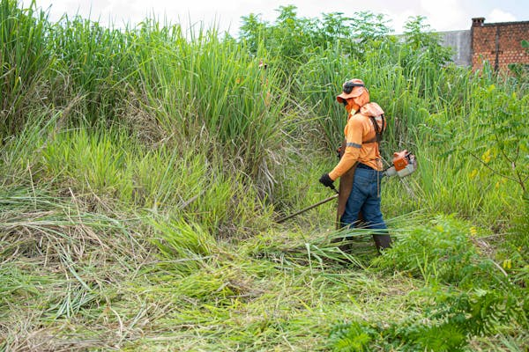
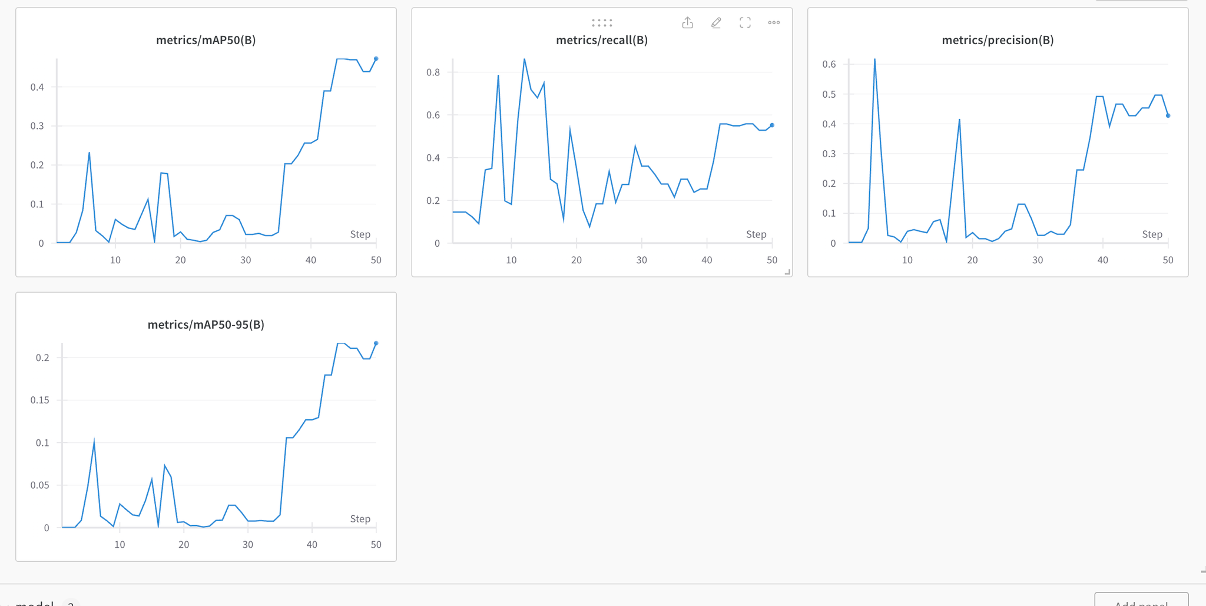
Problem 2: Environmental Sustainability
Model Use:
YOLOv8
Data Use:
10 Training images
Split images in to 24 smaller images for grass classification
Split images into another 32 smaller images for dead grass/live grass classification
Evaluation:

Slide 4

Problem 3: Digital Media
Model Use:
Resnet152
EfficientNetB7
VGG19
Data Use:
3,230 images
1615 AI generated
1615 Real
Evaluation:
Consistently 90-100% accuracy on 2 different test set

Slide 5
Thank You For Watching!

